Slide 1

Predicting IMDb Ratings
Nathan Higley, Nancy Mathur, Robert McLauchlan, Ryan Winn

Slide 2
Data Collection

Slide 3
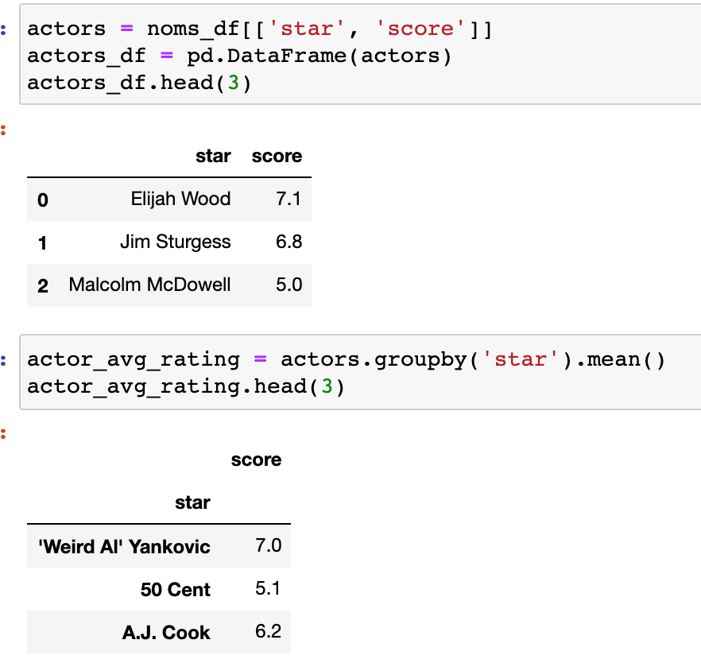

Merging Data

Slide 4
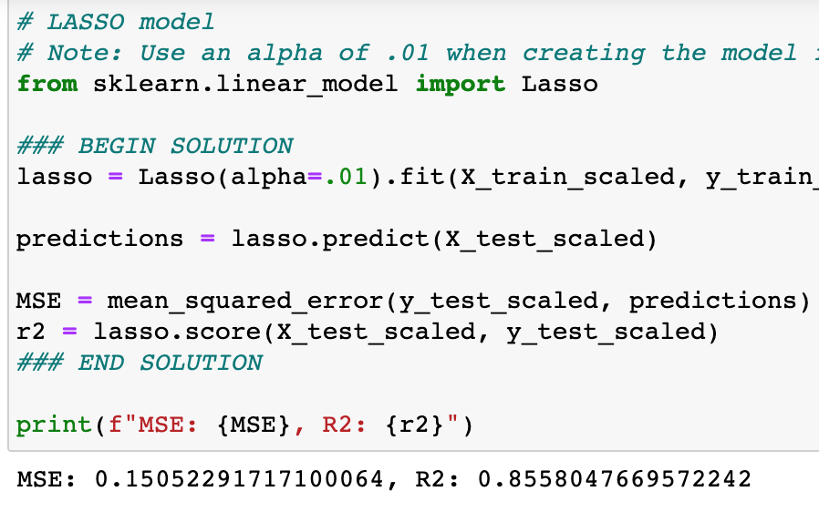
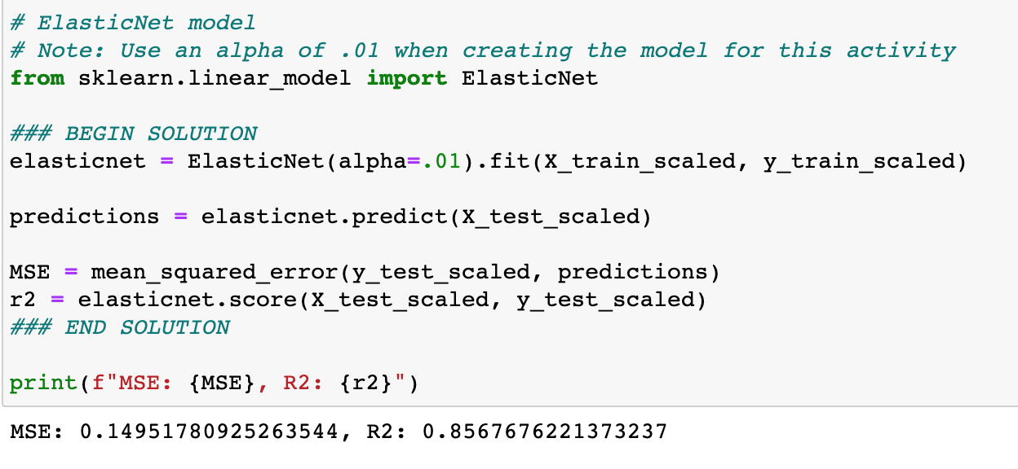
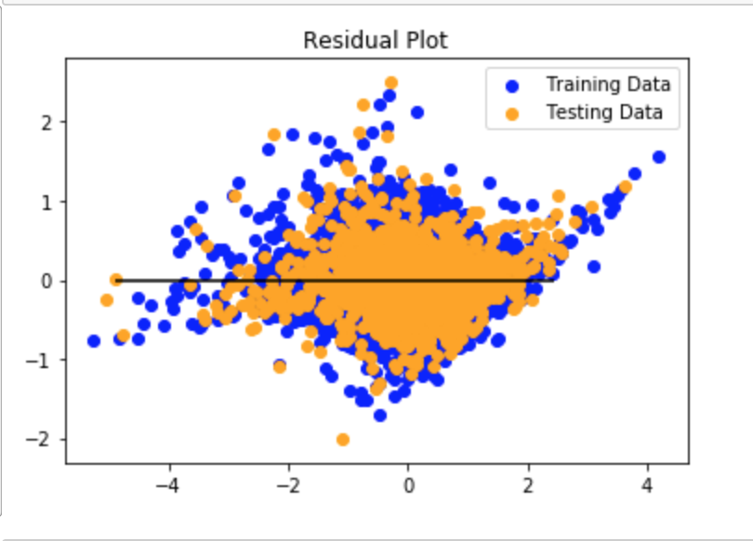
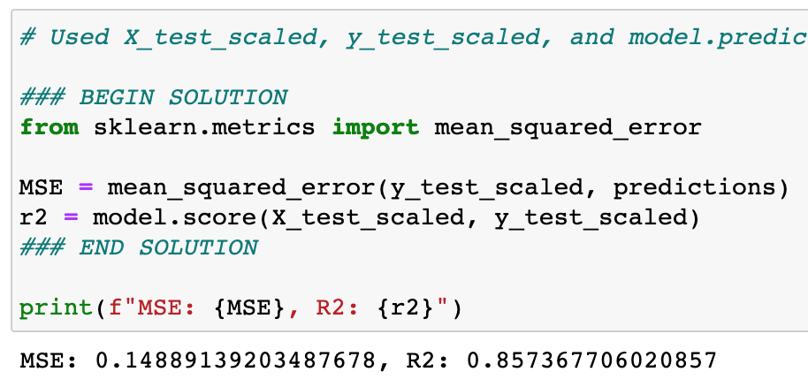
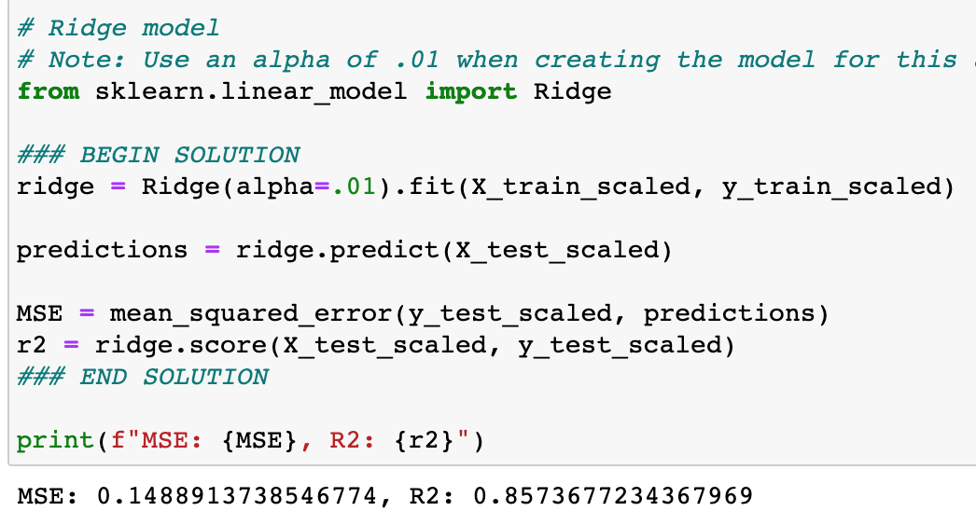
Linear Regression

Slide 5
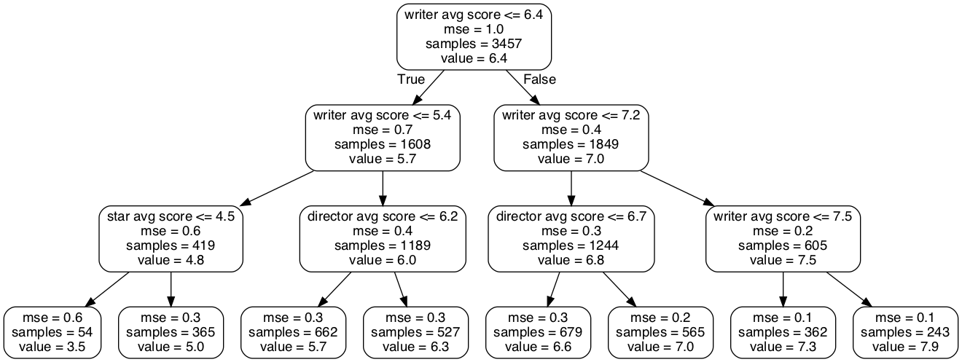
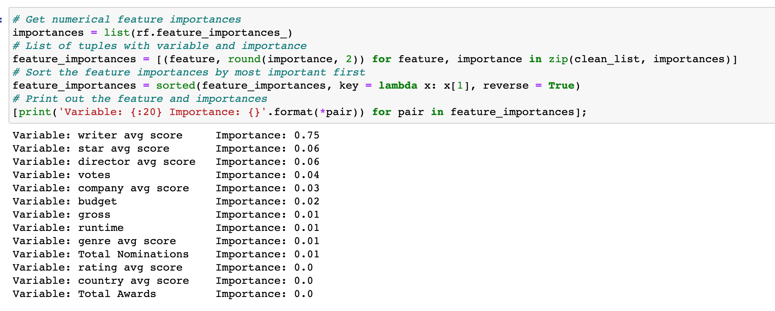
Random Forrest

Slide 6
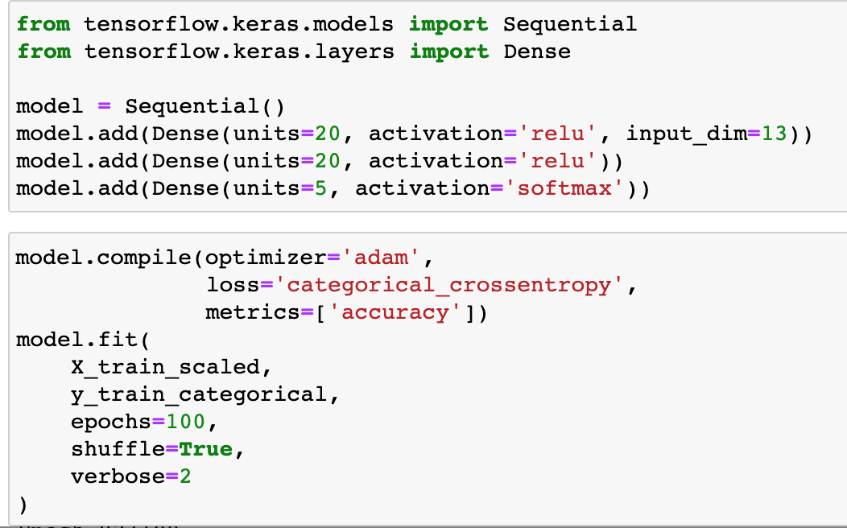


Deep Learning Model
5 Classes

Slide 8
Tableu

Slide 9
Conclusion

